Slide 1

HPC Project
Hybrid MPI + OpenMP Parallel K-Means
On CIFAR-10 Image Embeddings
By Sadhana Devarajan
DISTRI-CLUSTER
50,000 CIFAR-10 VECTORS
512 DIMENTIONS
K=10 CLUSTERS

Slide 2
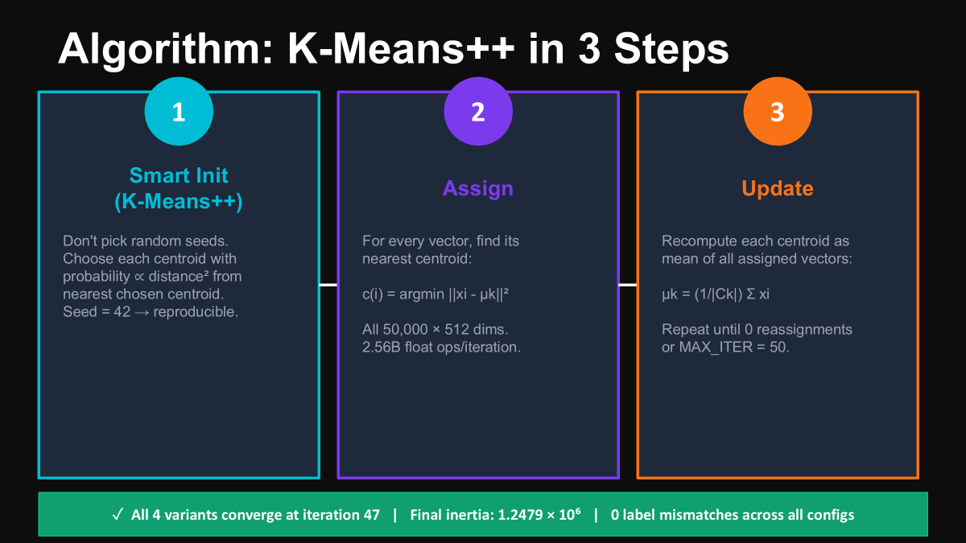

Slide 3
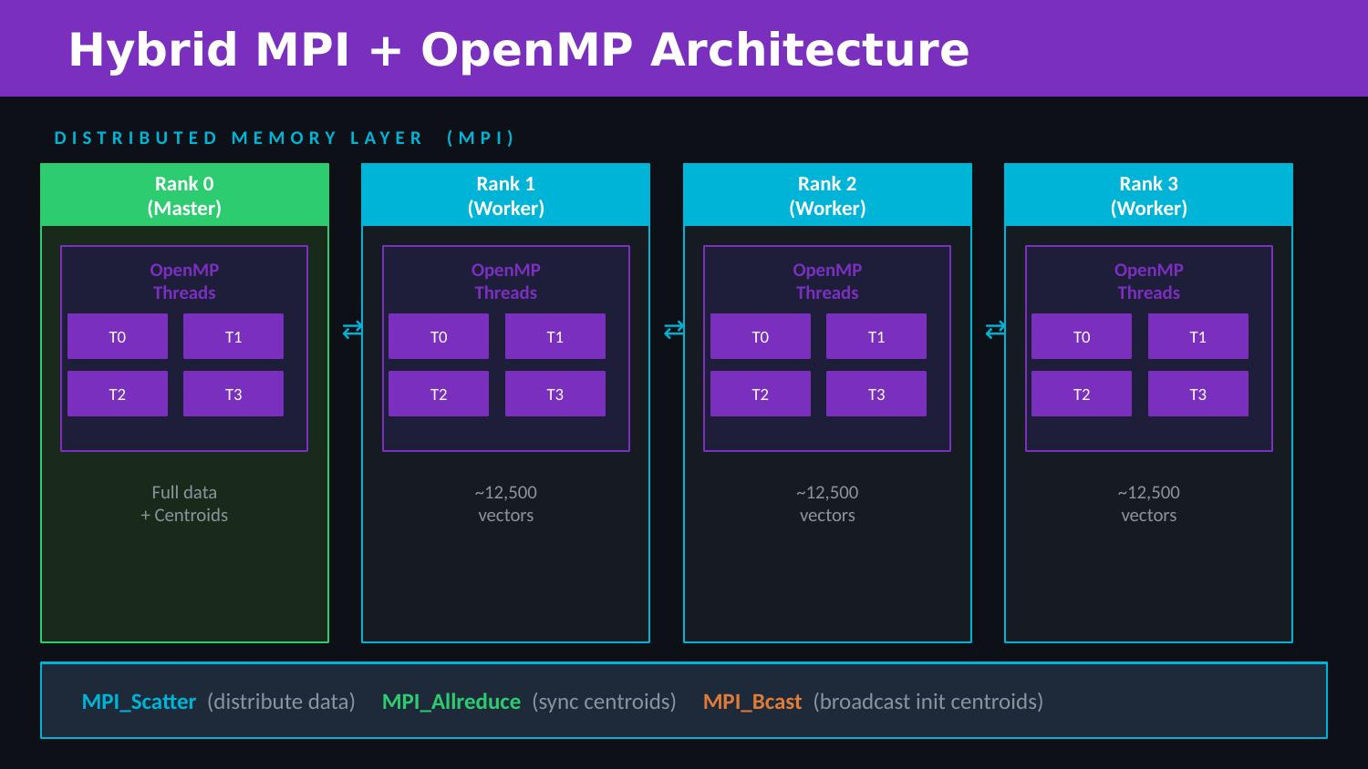

Slide 4
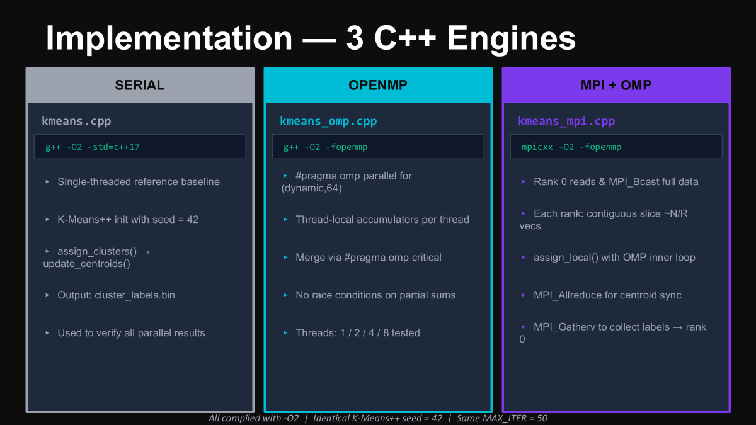

Slide 5
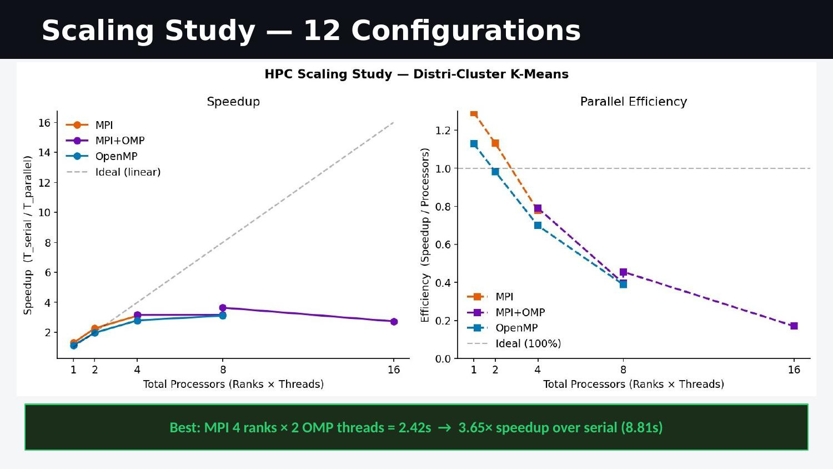
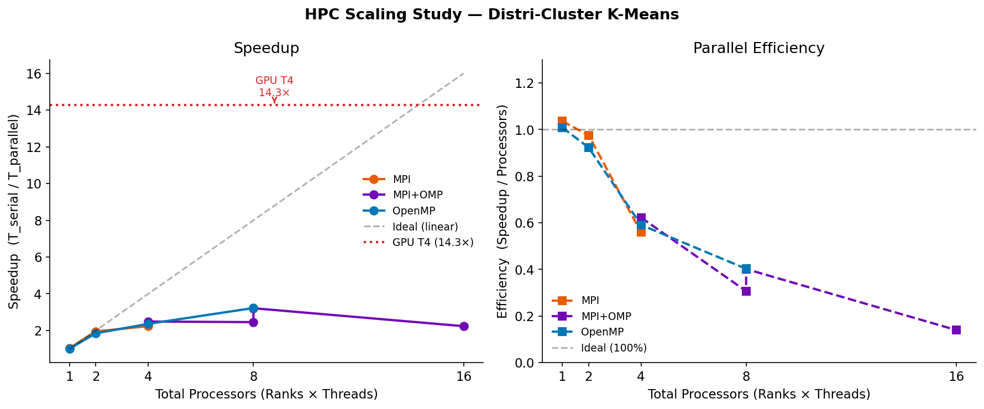

Slide 6
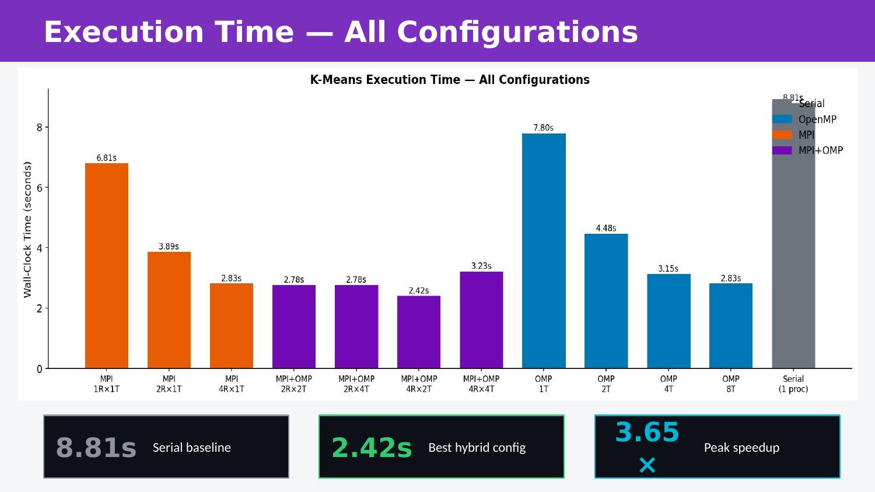


Slide 7
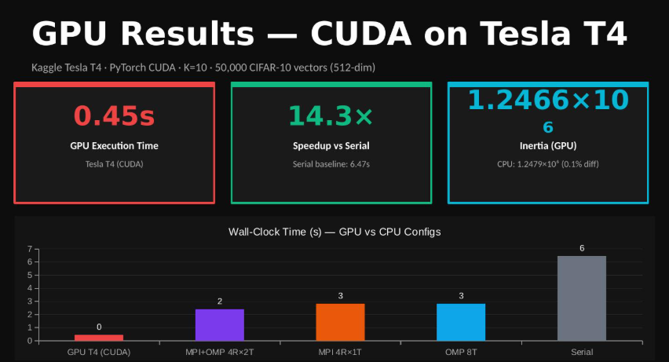

1.244 x 10^6

Slide 8
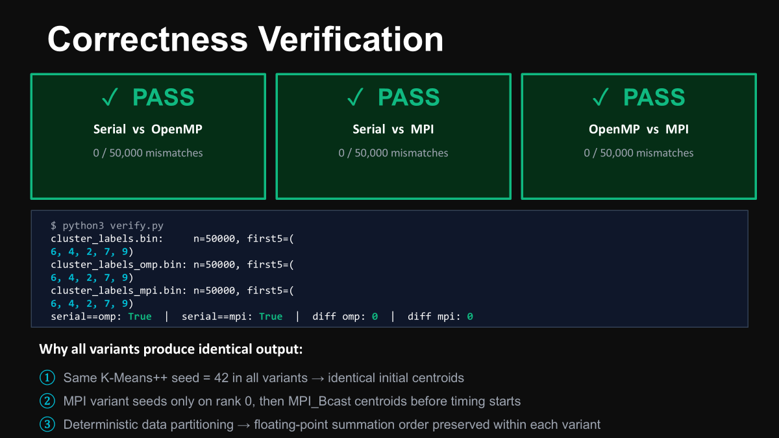

Slide 9
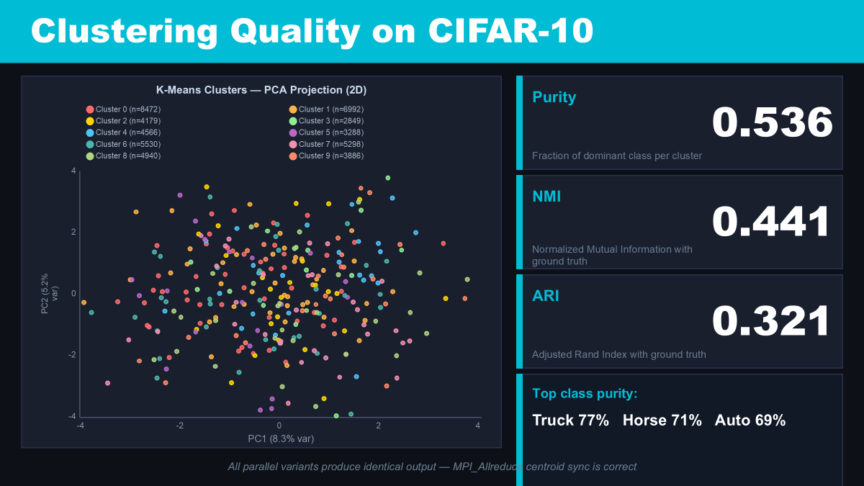
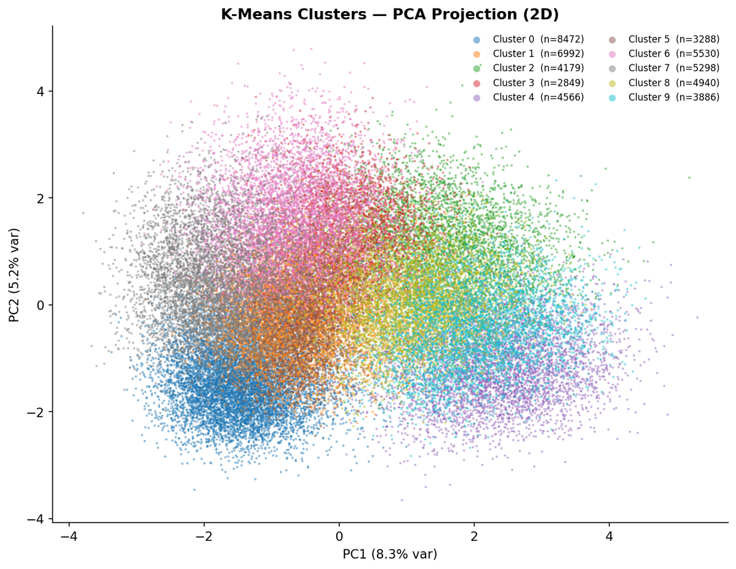

Slide 10
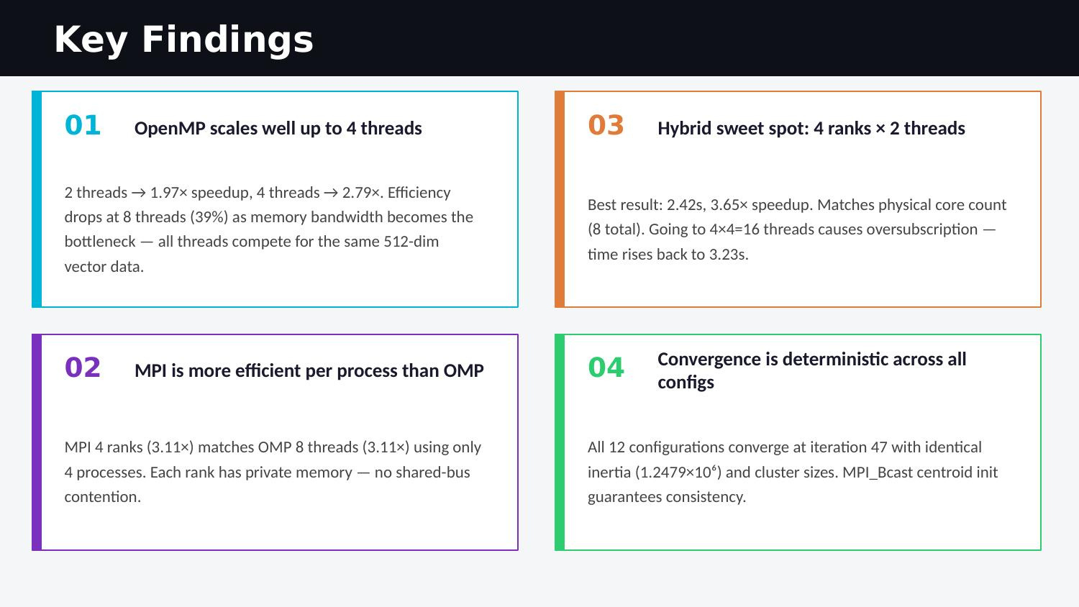

Slide 11
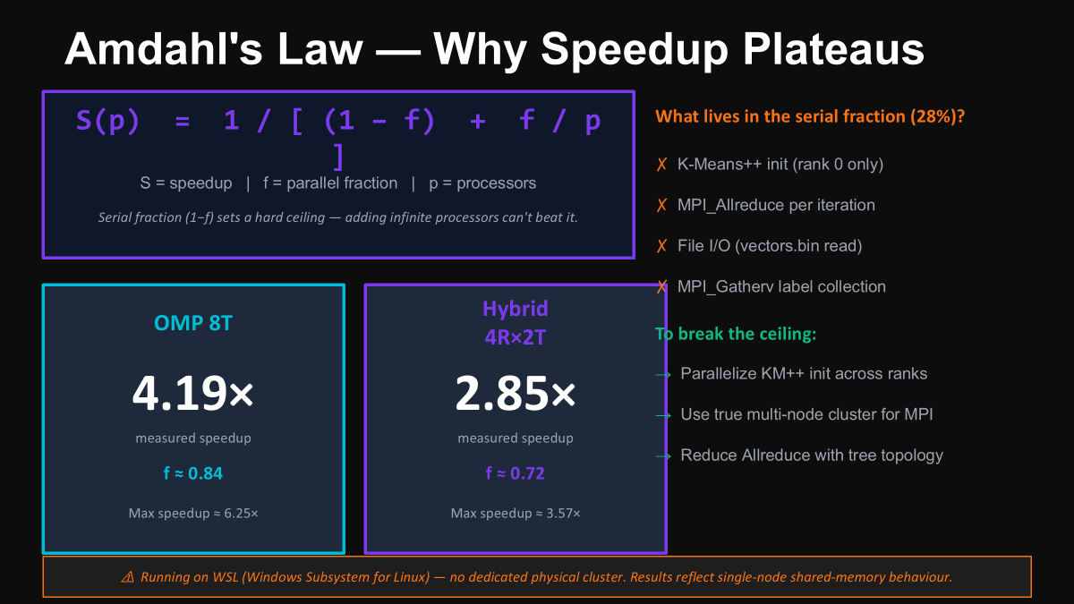

Slide 12
